Slide 1


Daniel MALANGU [13315120] Jocelyn BONDJOBO [13232852] Eunice Naa Korkoi HAMMOND [13222563] Heinrich J. BURGERS [15059538] TIM KIRKER [11152402]
CODE X

Slide 2

WHAT IS OUR SYSTEM?
The core of the system is a search engine which is enriched with functionalities of performing some machine learning in order to retrieve a product in a master file found in a database running on the server through RESTful calls.

Slide 3
PROGRESS REPORT
Due to a change in project scope, the following was done since the previous demo:
Research on big data databases
Major documentation changes
Implementation of improved search functionalities
Front end design of the application
Java integration with ZIZO Database

Slide 4
WOW FACTOR
Implemented/To be implemented
Dictionary in database
Machine Learning

Slide 5
BURNDOWN CHART
Task Number | Task Description | Status | Estimated days | Days Taken to Complete
1 | Alpha Planning & Scrum meeting | Completed | 2 | 2
2 | Research on Technology (Database & Testing) | Completed | 14 | 17
3 | Documentation | In Progress | 21 | 20
4 | Software architecture design & diagrams | In Progress | 10 | 6
5 | Database design and advanced search functionalities | Completed | 7 | 7
6 | Java-database integration | In progress | 7 | 3
7 | Front end design & integration | In progress | 5 | 4
8 | Framework Testing (JUnit & JMeter) | Not started | 10 | 0
9 | Machine learning research & Implementation | In progress | 21 | 2
10 | Demo 2 | In progress | 30 | 25

Slide 7
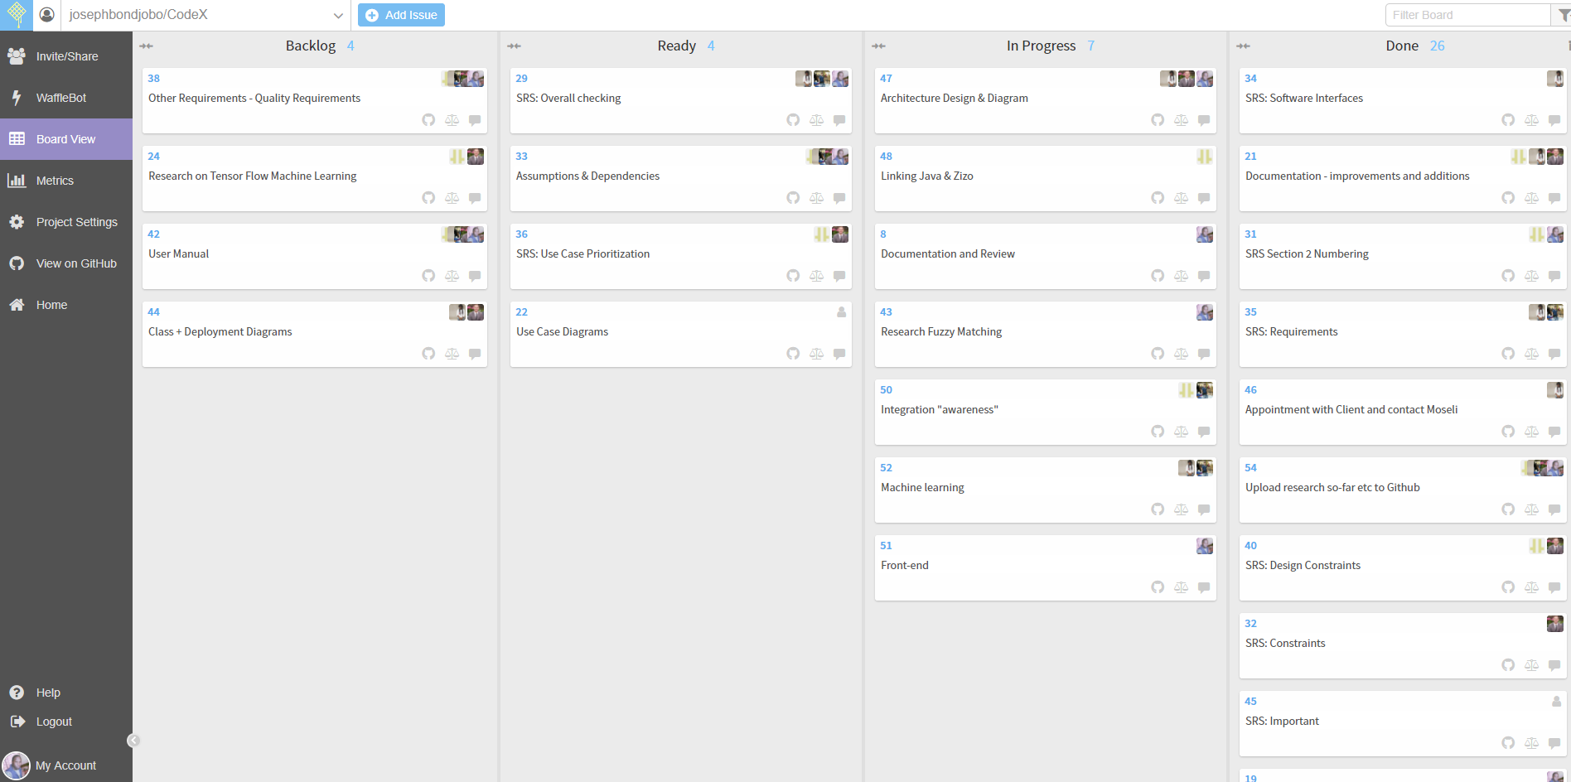
SCRUM BOARD

